Slide 1
PROJECT 7
BY: Said, Kareem, Mario

Slide 2
PRESENTATION
Theme: Bank Personal Loan Modelling
Data shape : 5000 rows and 14 columns.
Goal: Practise in supervised learning using Bank data. We need to create the model for the rating prediction.

Slide 3
PROCESS
Examine the dataset
Plan our work on Trello
Implement the models
Select the best model
Dashboard
Presentation
Research the models
Clean the dataset

Slide 4
LEARNINGS AND IMPROVEMENTS
LEARNINGS
IMPROVEMENTS
Better understanding of the models and how to use it on Python.
Better use of Tableau.
Better use of stremlit
Test again and again to have a better accuracy.

Slide 5
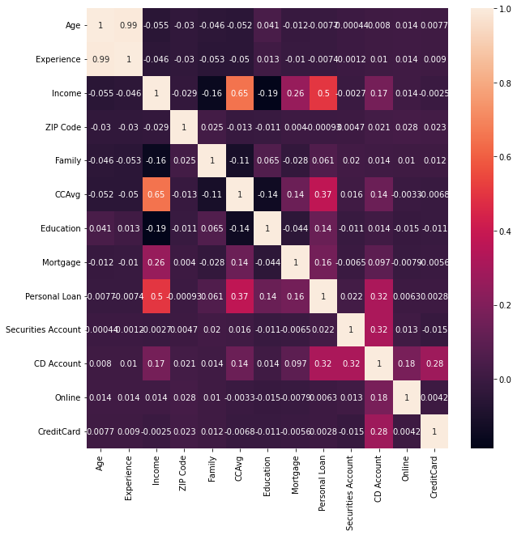
TARGET: 7 CLASSES

Slide 6
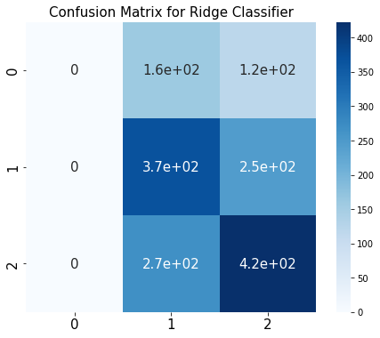
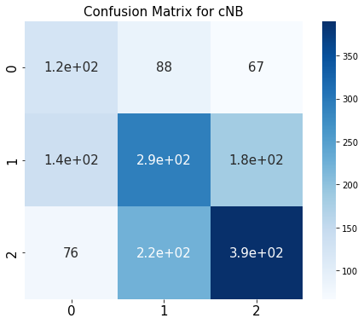
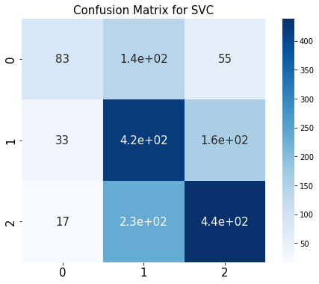
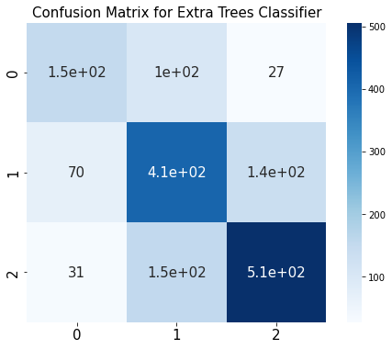
TARGET: 3 CLASSES BAD, MEDIUM & GOOD
Class | Class_no | RATING | No_movies
BAD | 0 | 0-5.5 | 1386
MEDIUM | 1 | 5.5-7 | 3091
GOOD | 2 | 7-10 | 3438
Model | Accuracy | Precision |  |  | Recall |  |  | F1 score
 |  | Class 0 | Class 1 | Class 2 | Class 0 | Class 1 | Class 2 | Class 0 | Class 1 | Class 2
Ridge Classifier | 50% | 0% | 46% | 54% | 0% | 60% | 61% | 0% | 52% | 57%
Categorical NB | 51% | 37% | 48% | 61% | 45% | 48% | 57% | 40% | 48% | 59%
SVC | 60% | 62% | 53% | 67% | 30% | 69% | 64% | 40% | 60% | 65%
Extra Trees Classifier | 67% | 60% | 61% | 76% | 54% | 66% | 73% | 56% | 64% | 74%

Slide 7
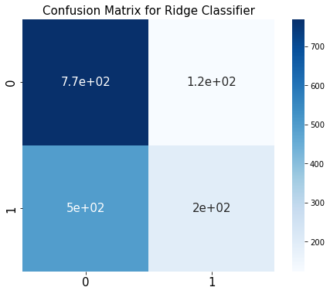
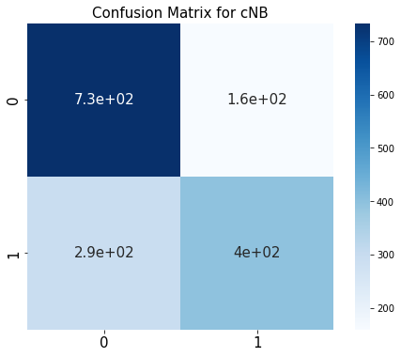
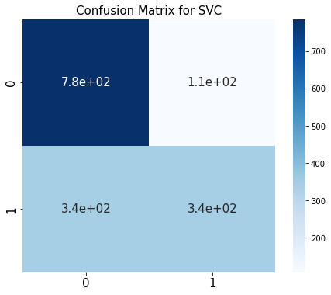
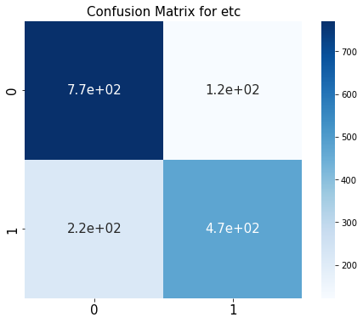
TARGET: 2 CLASSES BAD & GOOD
Model | Accuracy | Precision |  | Recall |  | F1 score |  | Roc_auc
 |  | Class 0 | Class 1 | Class 0 | Class 1 | Class 0 | Class 1
Ridge Classifier | 61% | 61% | 61% | 86% | 28% | 71% | 39% | 57%
Categorical NB | 71% | 71% | 71% | 82% | 57% | 76% | 64% | 70%
SVC | 71% | 69% | 76% | 88% | 50% | 78% | 60% | 69%
Extra Trees Classifier | 79% | 78% | 79% | 86% | 68% | 82% | 74% | 77%
Class | Class_no | RATING | No_movies
BAD | 0 | 0-7 | 4477
GOOD | 1 | 7-10 | 3438

Slide 8
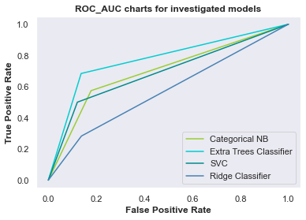
TARGET: 2 CLASSES BAD & GOOD
Model | Accuracy | Precision |  | Recall |  | F1 score |  | Roc_auc
 |  | Class 0 | Class 1 | Class 0 | Class 1 | Class 0 | Class 1
Ridge Classifier | 61% | 61% | 61% | 86% | 28% | 71% | 39% | 57%
Categorical NB | 71% | 71% | 71% | 82% | 57% | 76% | 64% | 70%
SVC | 71% | 69% | 76% | 88% | 50% | 78% | 60% | 69%
Extra Trees Classifier | 79% | 78% | 79% | 86% | 68% | 82% | 74% | 77%
Class | Class_no | RATING | No_movies
BAD | 0 | 0-7 | 4477
GOOD | 1 | 7-10 | 3438

Slide 9
DASHBOARD AND KPIS
Dashboard made on Tableau
6 user stories and 6 widgets:
Total number of movies
Average rating per kind
Top 10 Countries with the longest movies
Average runtime per kind
Number of movies per country
Number of votes per year
Link: Netflix - Key Metrics | Tableau Public

Slide 10

THANK YOU!

